Slide 1



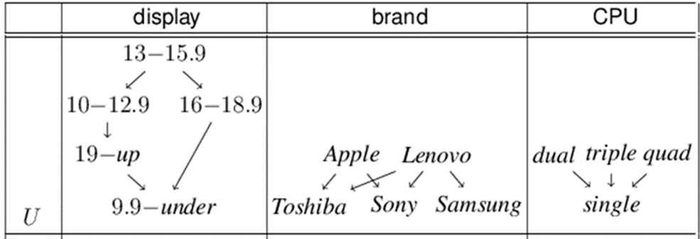
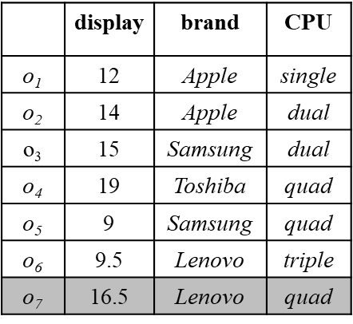
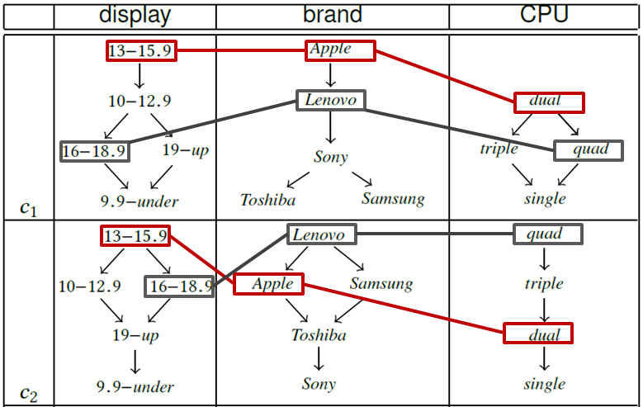
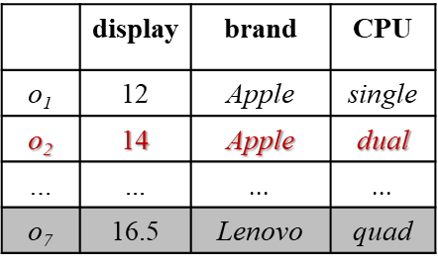
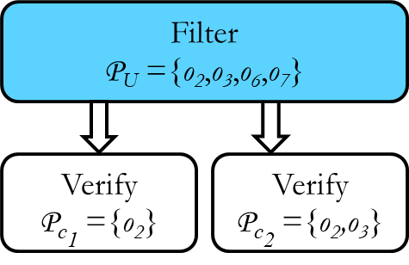
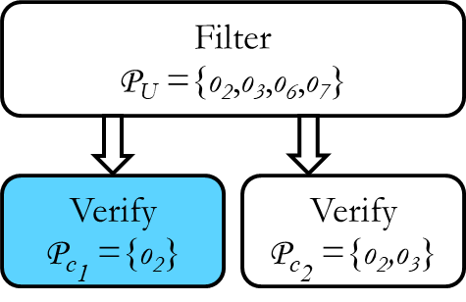
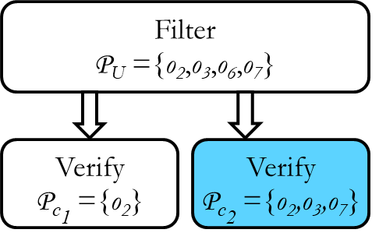
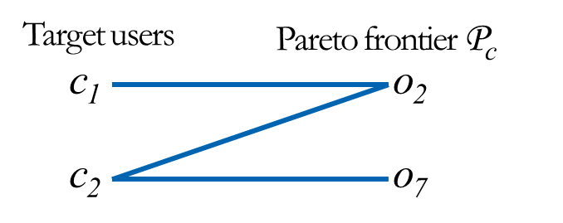
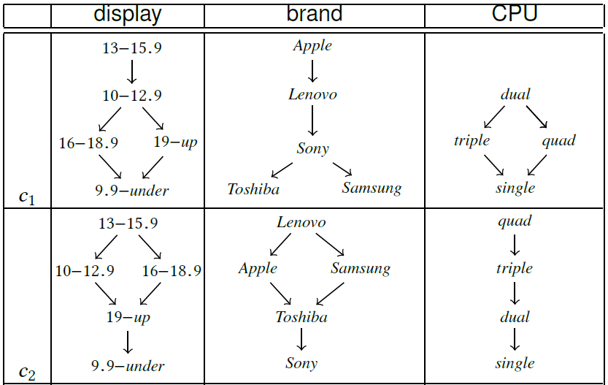
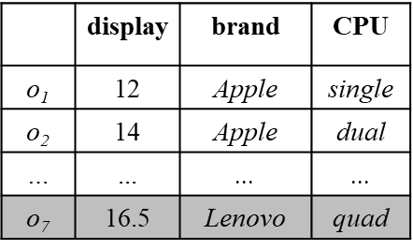
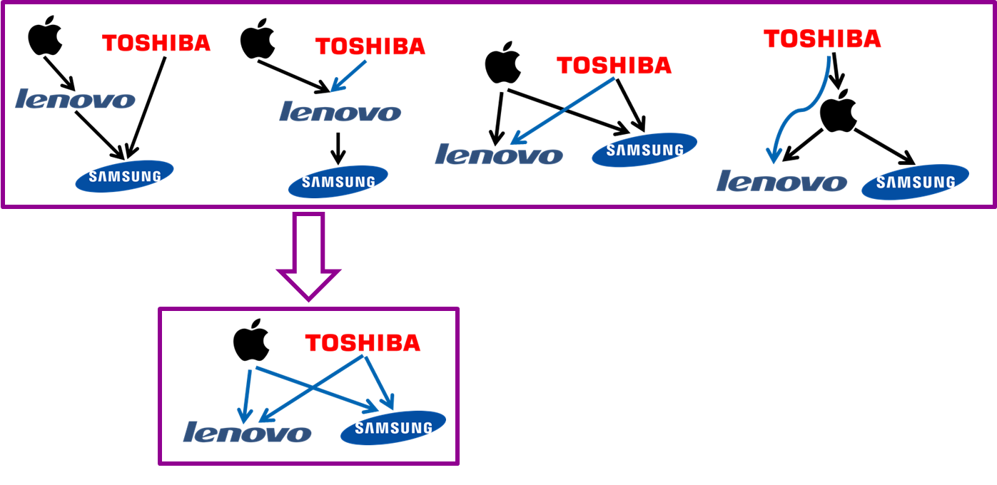
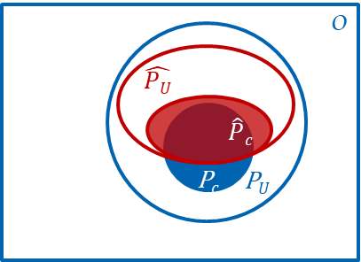
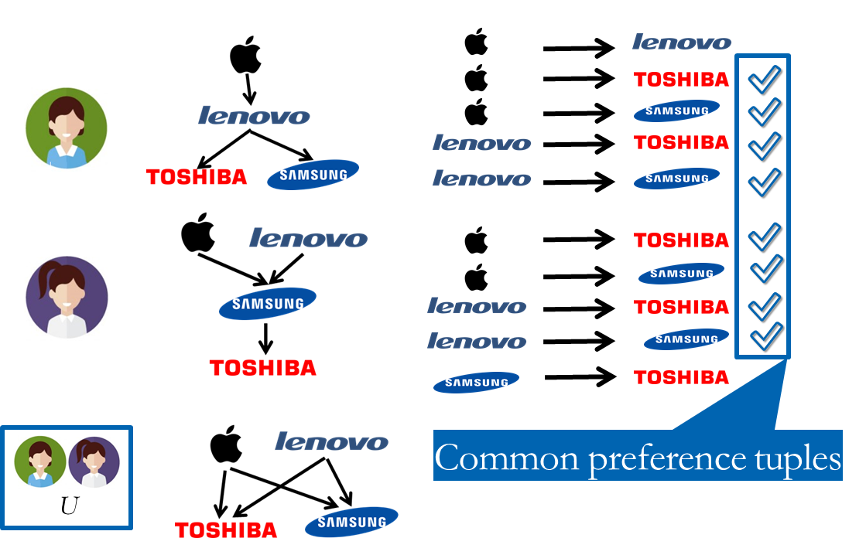
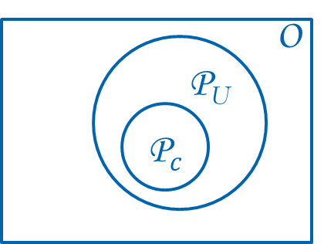
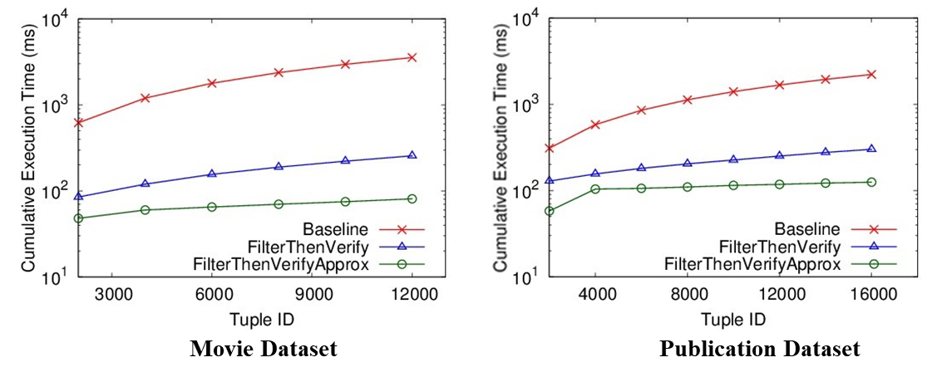
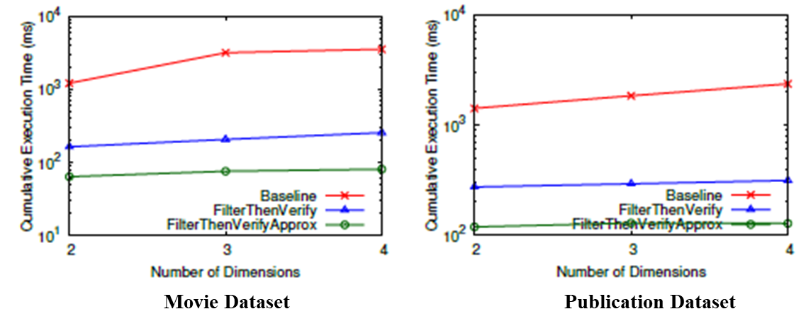
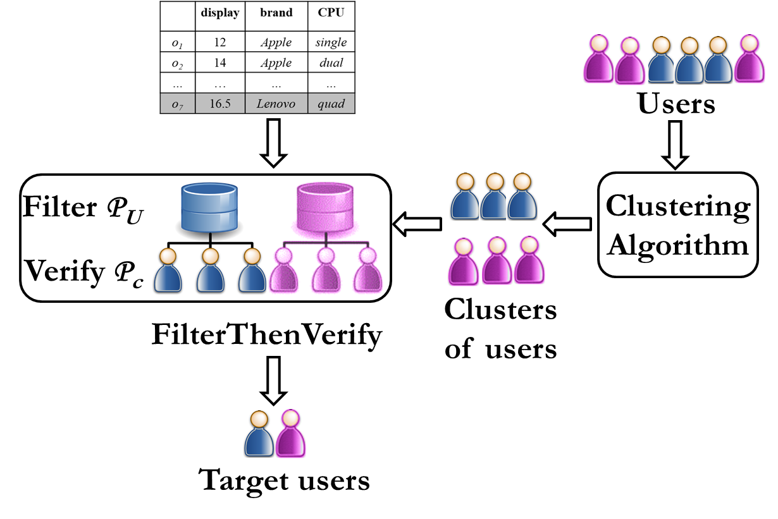
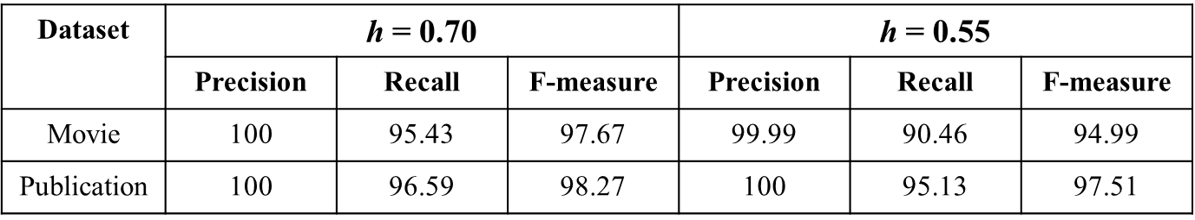

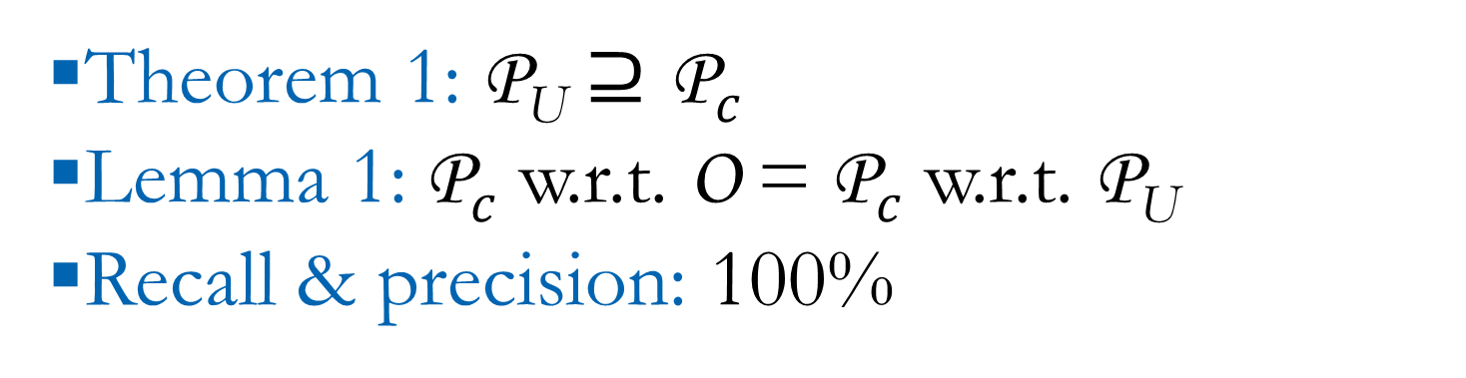
Continuous Monitoring of Pareto Frontiers over
Partially Ordered Attributes for Many Users
21st International Conference on Extending Database Technology, Vienna, Austria, 2018
Afroza Sultana and Chengkai Li
The University of Texas at Arlington
Motivation
Algorithm FilterThenVerify
Recommendation based on users' preferences
Preferences with multiple attributes
Objects that ″stand out″
For each cluster in C
Filter: if U approve o in Pareto-optimality, stores o in P_{U}
Verify: for each c, determines whether o belongs to P_{c}
Genre
Author
Publisher
An Example
Similarity Functions
Pareto-optimal as
″stand out″
Jaccard similarity
|Common preference tuples|/|All preference tuples|
Weighted Jaccard similarity
Values near top have more impact
Maximal values: no other value is preferred over
Weighted preference tuples
Got HP most comfortable
Problem Formulation
Find target users such that o₇ is in Pareto frontier.
Approx. Common Preference Tuples
c₂
Preferences can be diverse
Tiny clusters
Relax idea of common preference tuple
Preference polling
Challenges & Ideas
Exhaustive comparisons
For every user
With every Pareto-optimal object
A number of users
Objects streaming
Efficient dissemination
Sharing computation across users
Experimental Evaluation
Movie Dataset: 12,749 movies: joined Netflix dataset with data from IMDB
Publication Dataset: 17,598 publications: ACM Digital Library
Theorem 1: P_{U} $⊇\text{P}c$
Lemma 1:$\text{P}c$ w.r.t. O = $\text{P}c$ w.r.t. P_{U}
Recall & precision: 100%
Efficacy of FilterThenVerifyApprox
Which users share preferences?
Cluster users based on preferences
No prior study on clustering for partial orders
Define similarity functions w.r.t. partial orders
System Architecture

